Slide 1

SOLAR-POWERED VAPOUR ABSORPTION SYSTEM
Under the Guidance of: Presented by
K.SRINIVAS PRASAD P.GOWTHAMI POORNIMA
Assistant professor S.MAHABOOB BASHA
Mechanical Engineering P.SAMPATH

Slide 2
OVERVIEW
INTRODUCTION
OBJECTIVE
COMPONENTS
LAYOUT
PROCESS DESCRIPTION
SPECIFICATIONS
ADVANTAGES OF SOLAR POWER
ADVANTAGES OF VAPOUR ABSORPTION REFRIGERATION SYSTEM
APPLICATIONS
CONCLUSION

Slide 3
INTRODUCTION
A solar heat operated system.
Quite similar to vapor compression system.
Compressor is replaced by pump, generator and absorber.
Ammonia is used as refrigerant i.e R-717.
Heat in generator is supplied by solar electrical power stored in battery.
Condensation, expansion and evaporation processes are same as the VCR system.

Slide 4
OBJECTIVE
To make effective refrigeration making use of Solar Energy.
One-time investment with minimum running expenses.
Pollution-free Free system.
Refrigeration system having “Low Maintenance Cost ”.

Slide 5
COMPONENTS
ABSORBER
GENERATOR
SOLAR PANEL
CONDENSER
EXPANSION VALVE
EVAPORATOR
DC BATTERY
FAN

Slide 6
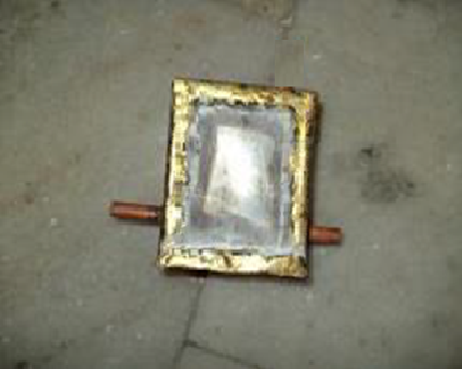
ABSORBER
Used to store the mixture of water and ammonia in particular proportion .
Function is to produce the required aqua ammonia solution.
Low pressure NH₃ vapour is absorbed by the weak solution of NH₃ which is stored in the absorber.

Slide 7
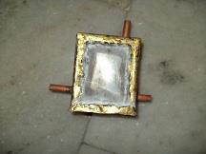
GENERATOR
Heats the strong aqua ammonia solution up to the boiling temperature of ammonia solution to produce ammonia vapors.
Here, solar panel is used for the heating purpose.
Separates the dissolved ammonia from the water-ammonia solution.

Slide 8
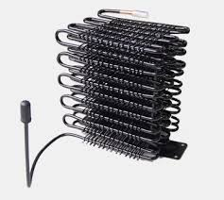
CONDENSER
A device or unit used to condense a substance from its gaseous to its liquid state.
Application areas include air conditioning, industrial chemical processes such as distillation, steam power plants, and other heat-exchange systems.

Slide 9
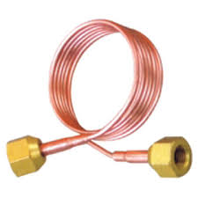
EXPANSION VALVE
Controls the amount of refrigerant flow into the evaporator .
Cause a pressure drop (Isenthalpic) of the working fluid.
Causes sudden drop in temperature.
Type of expansion valves used capillary type expansion valve.

Slide 10
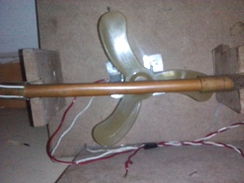
EVAPORATOR
Absorption of heat from the surroundings.
heat transfer is done by forced convection or natural convection.
Application areas: food and beverage industry, pharmaceutical industry.

Slide 11
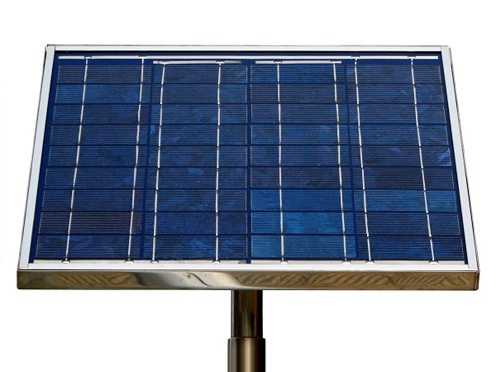
SOLAR PANEL
The electricity for heating coil is obtained from the solar panel.
The solar panel used in the project is of 60W and 4A.
Usually made up of p-n silicon semiconductors, aluminium or fibre glass. Fibre glass is widely used.

Slide 12

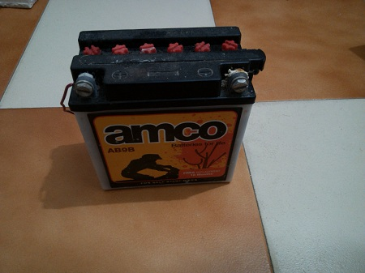
FAN
DC BATTERY
12V & 9Amp

Slide 13
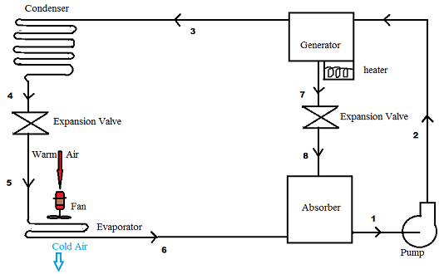
LAYOUT OF SOLAR POWERED VARS

Slide 14
PROCESS DESCRIPTION
Ammonia solution is pumped to generator with the help of pump.
Ammonia solution is heated to a temperature suitable for separating ammonia vapor from ammonia solution.
Ammonia vapors condenses in the condenser .
Liquid ammonia from condenser expands through expansion valve.
Chilled ammonia causes cooling effect in the evaporator.
Finally ammonia is transferred to absorber and the whole process continues.

Slide 15
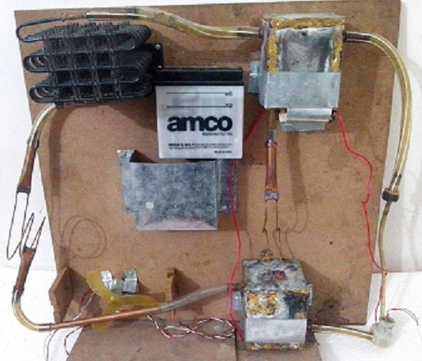
Vapor Absorption Refrigeration System Setup
Generator
Condenser
Expansion
Valve
Absorber
Pump

Slide 16
VARS – Specifications
ABSORBER
Length= 10 cm, Breadth= 10 cm, Height= 12.5 cm.
Material used: Galvanized iron.
GENERATOR
Length= 10 cm, Breadth= 10 cm, Height= 12.5 cm.
Material used: Galvanized iron.
HEATING COIL
It is made of nichrome wire.
Specifications: Length 20 cm

Slide 17
Cont….
EXPANSION COIL
Length = 35cm
Outer diameter= 0.175 cm
Material used: Copper
CONDENSER
Length= 15 cm, Width= 8 cm, Height= 17 cm.
Number of turns= 28
Inner diameter = 0.4297 cm.
CAPILLARY TUBE
Length= 35 cm, Outer diameter=0.4297 cm.

Slide 18
LAYOUT OF SOLAR POWERED VARS

Slide 19
CALCULATIONS
Heat absorbed in evaporator = m_{r} (h₆ – h₅)
= 210 kJ/min.
Heat generated in generator = m_{r} (h₃ – h₂)
= 304.2 kJ/min.
Heat rejected from condenser = m_{r} (h₄ – h₃)
= 211.6 kJ/min.
Work input to pump = 9.6 W
COP = heat absorbed in evaporator
work done by pump + heat supplied in generator
= 0.69

Slide 20
ADVANTAGES OF SOLAR ENERGY AS POWER SOURCE
Non- polluting and clean source of energy.
Renewable source of energy.
Immense source of energy.
Capacity to satisfy present and future needs.
High intensity in summer season.

Slide 21
ADVANTAGES OF VAPOUR ABSORPTION REFRIGERATION SYSTEM
Uses low grade energy like heat.
Ex- exhaust from I.C engine.
Less moving parts.
Smooth operation.
Can work on lower evaporator pressures, without affecting the COP.
Very efficient for higher load conditions.

Slide 22
APPLICATIONS
Air conditioning machines.
Food Processing Industries.
Jute Industries.
Commercial purposes.

Slide 23
CONCLUSION
Using Solar Energy as the power source of the system proved to be feasible.
Solar Energy being a renewable source of energy proved to be efficient as compared to using electrical energy or steam at the same place .
With the flow of ammonia through the system, we were able to use it as an air conditioner and that too with the help of renewable and non-polluting source of energy, i.e. , solar energy.

Slide 24


